Slide 1
Learning from Vermont Farm to Plate
April 21, 2016 / 12:00 to 1:00pm
Erica Campbell Vermont Farm to Plate
Brent Mansfield BC Food Systems Network
Sustainable Food Systems Working Group

Slide 3
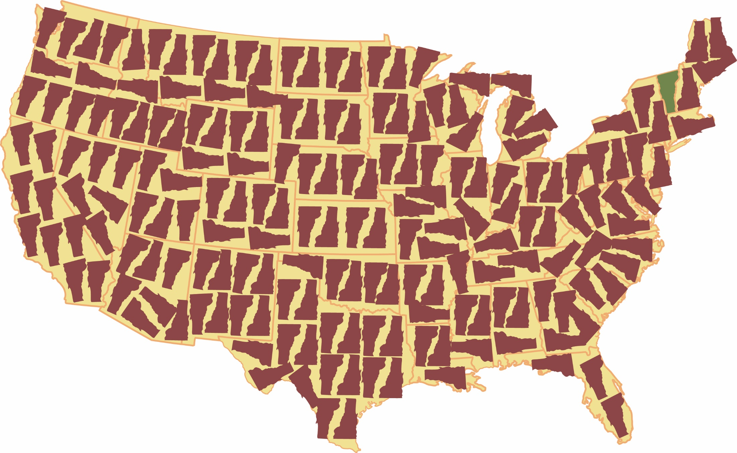

Slide 4
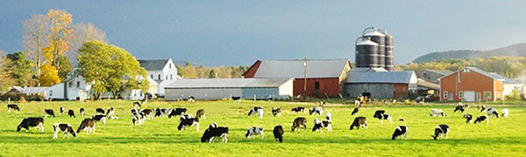
The overarching outcomes of the F2P Strategic Plan, as authorized by the Vermont Legislature, are to:
increase jobs and economic activity in VT’s farm and food sector
improve access to healthy, local foods for all Vermonters
improve environmental quality (soil, water, energy) upon which good food depends

Slide 5
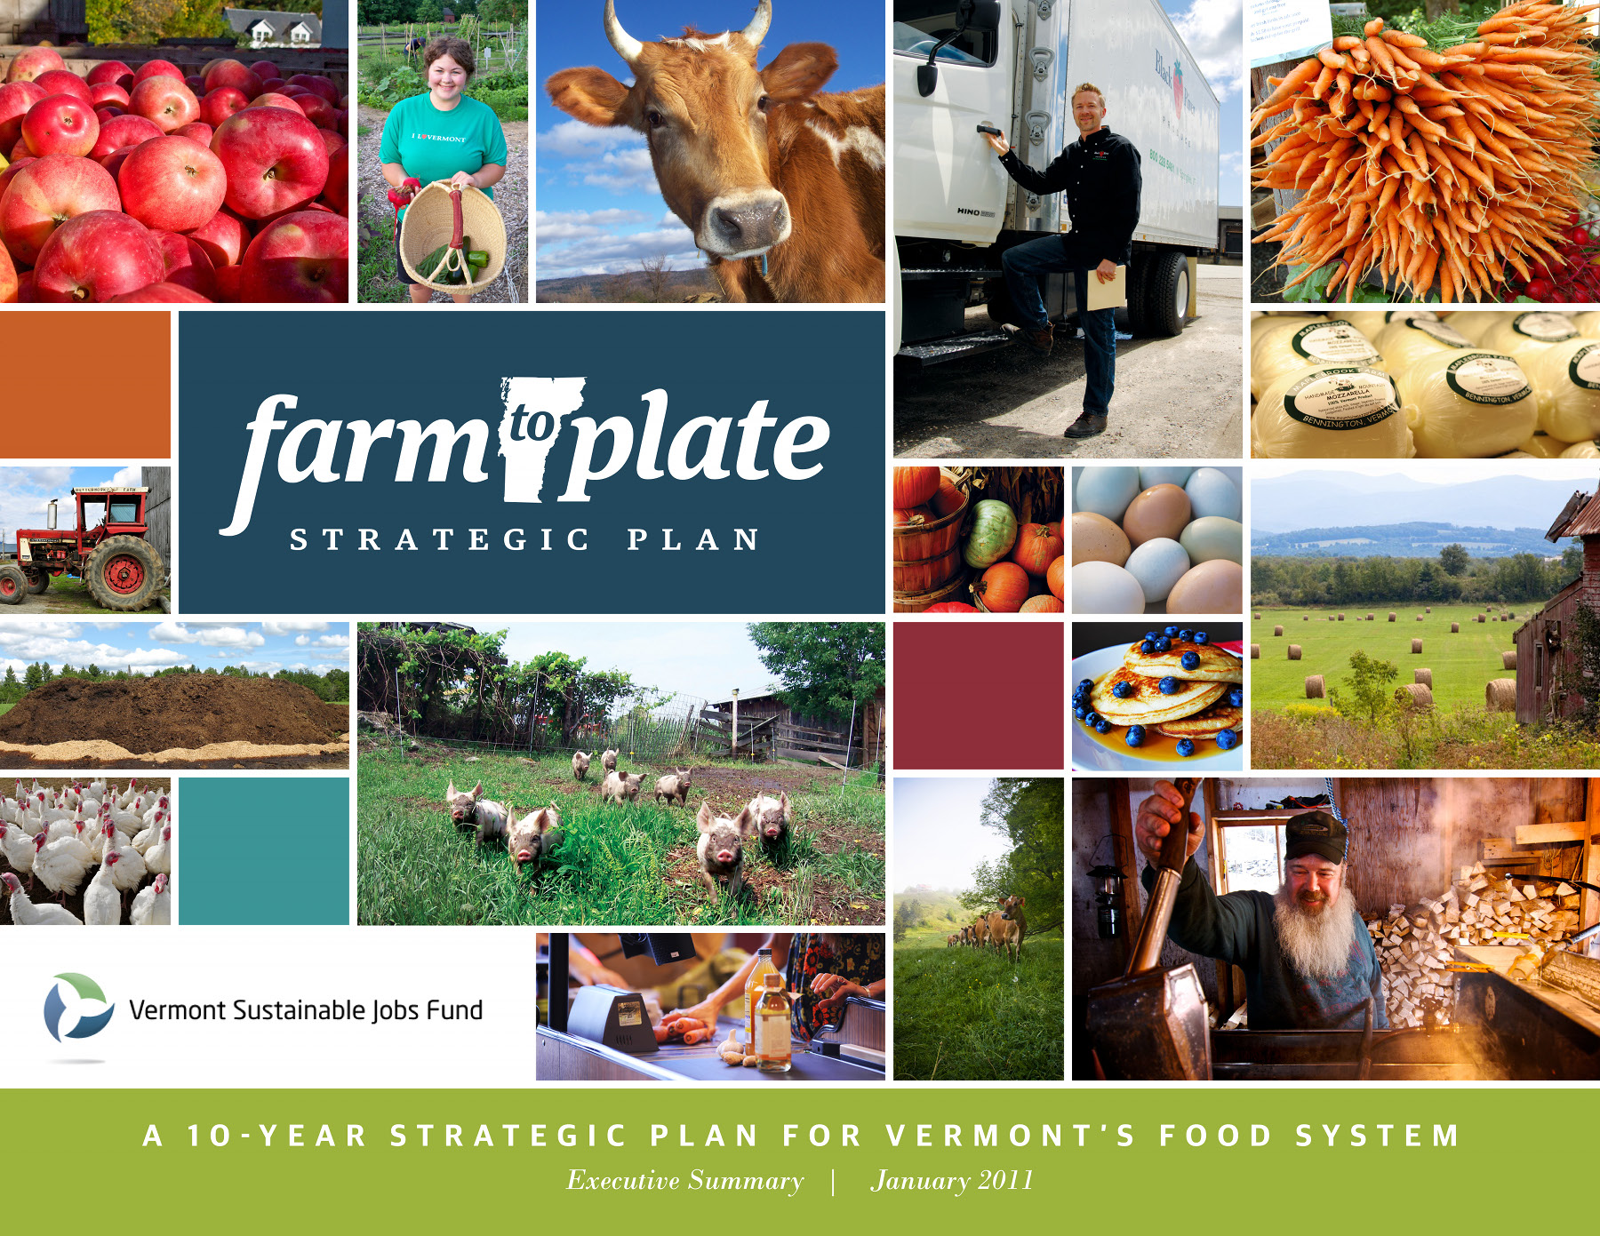

Slide 6
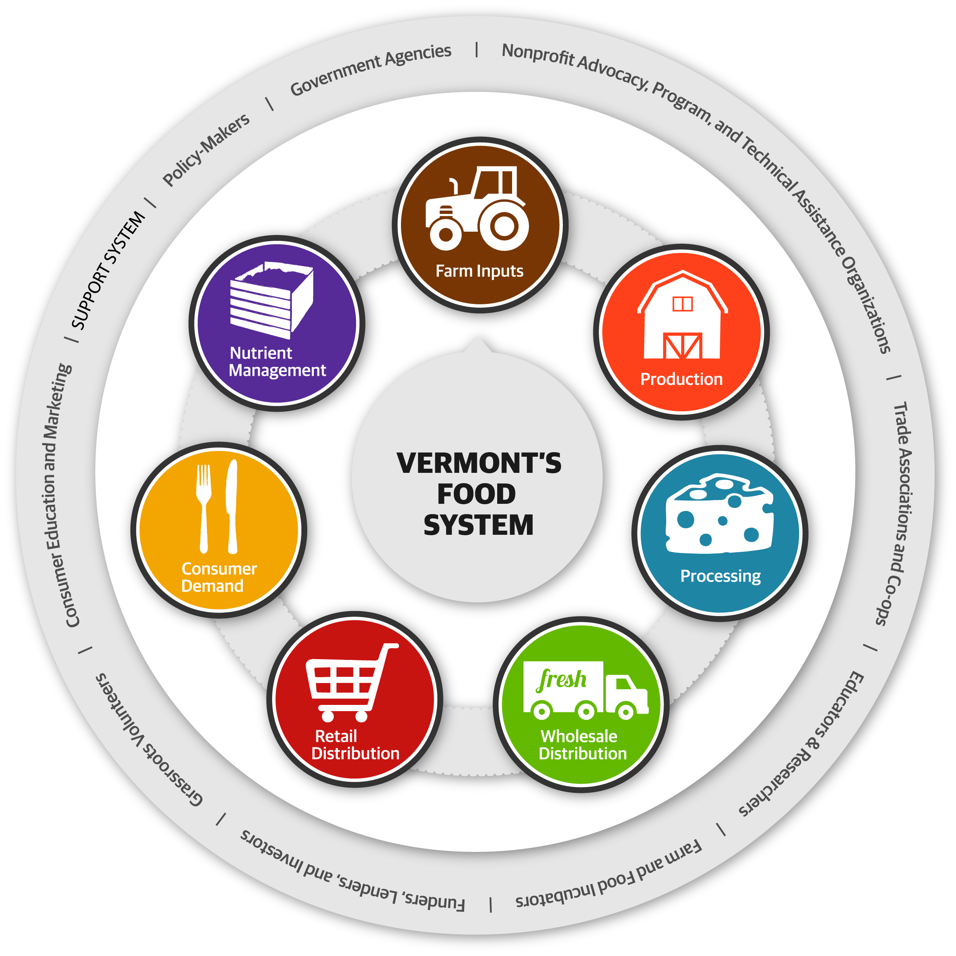
Notes:
Put old diagram

Slide 7
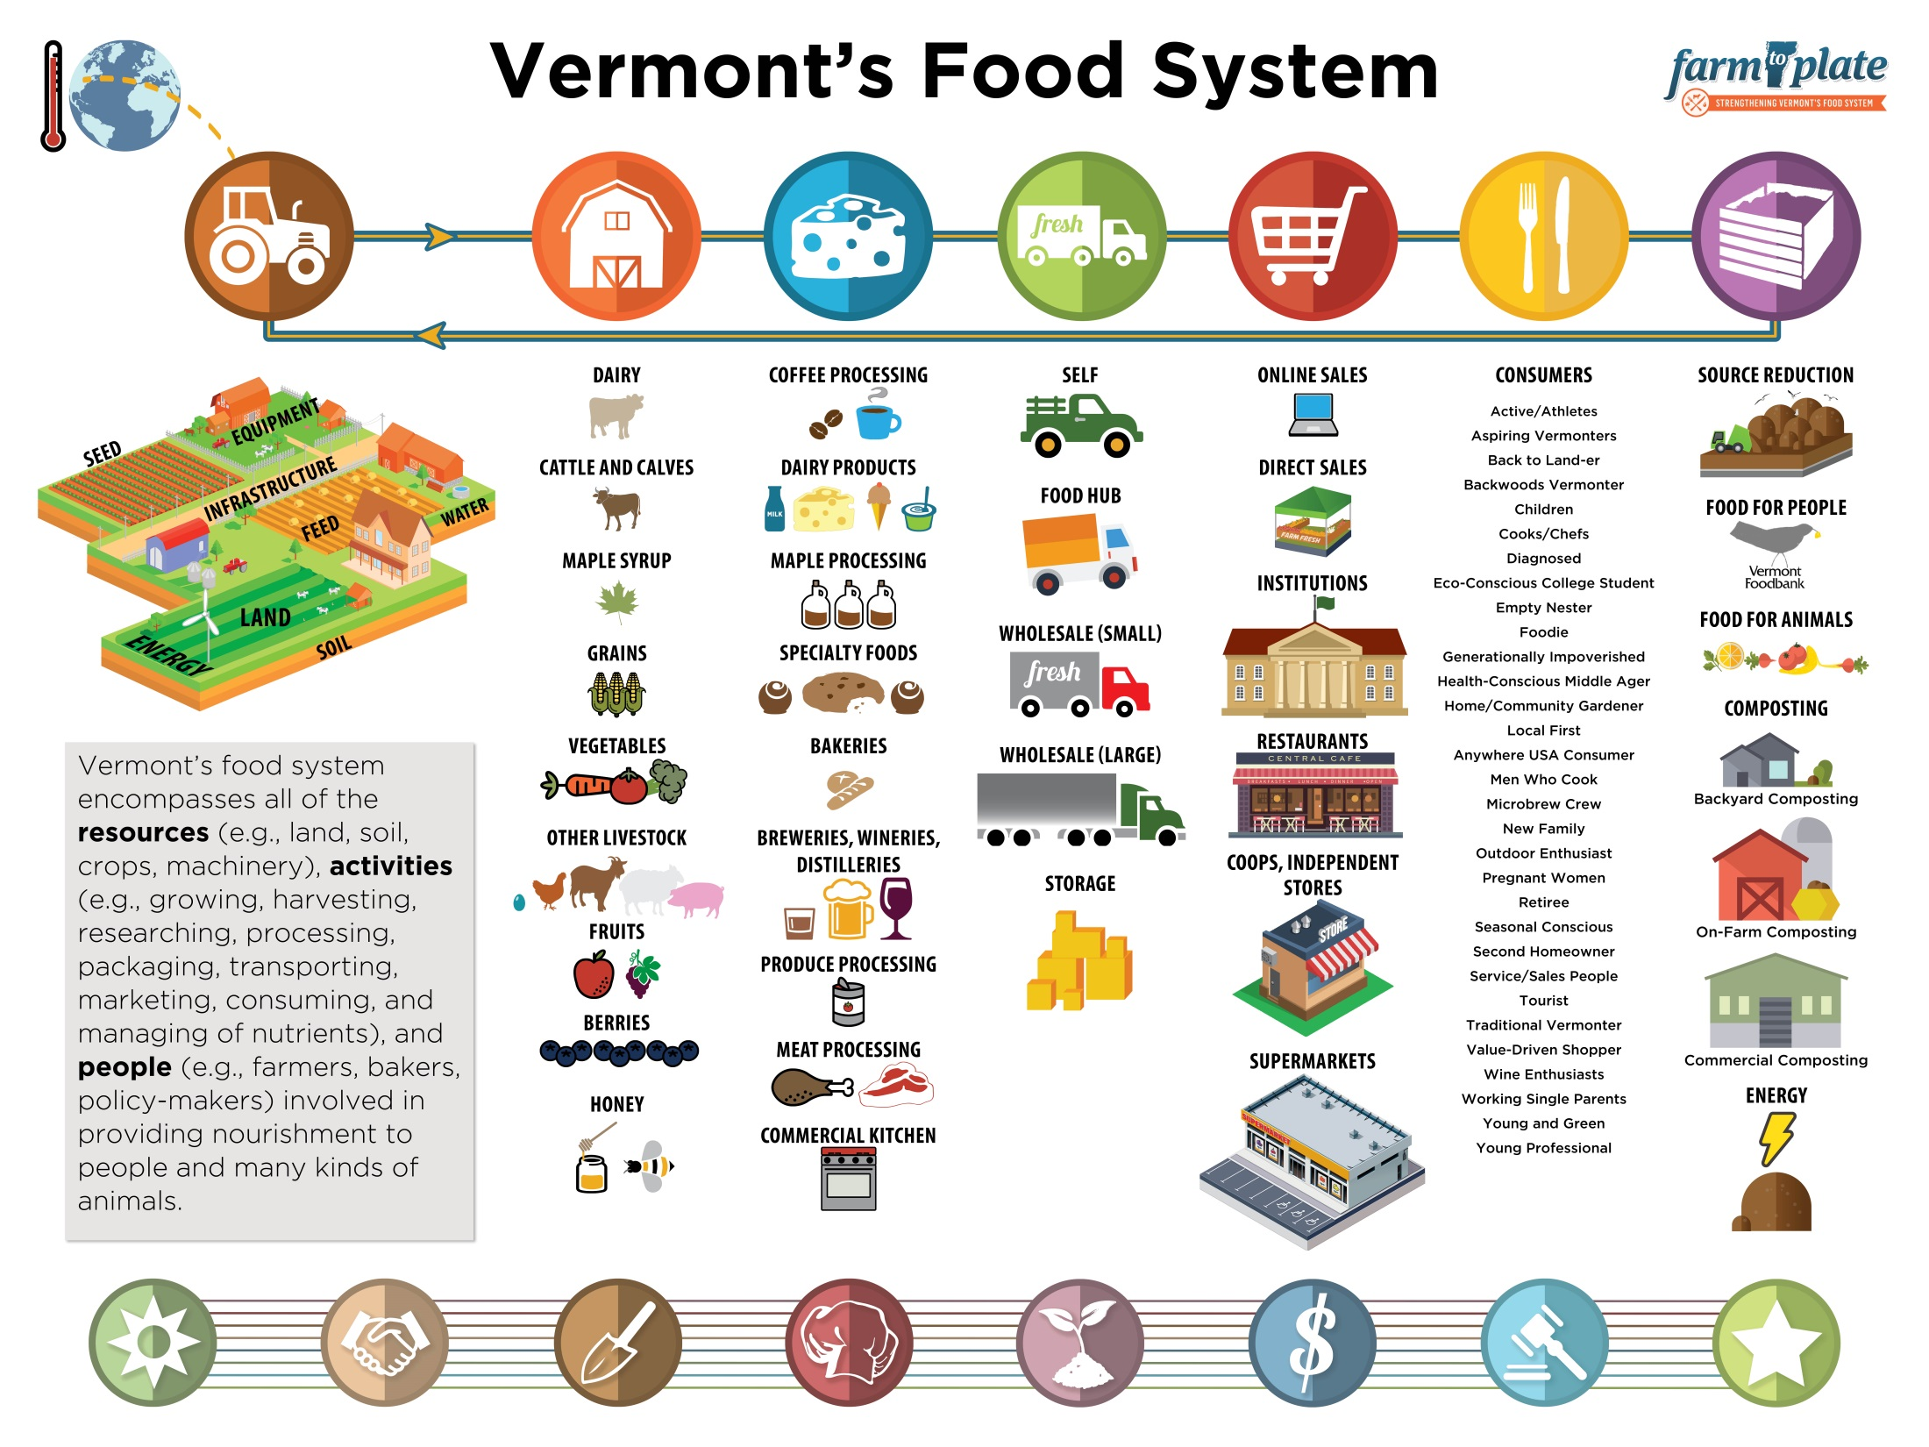

Slide 8
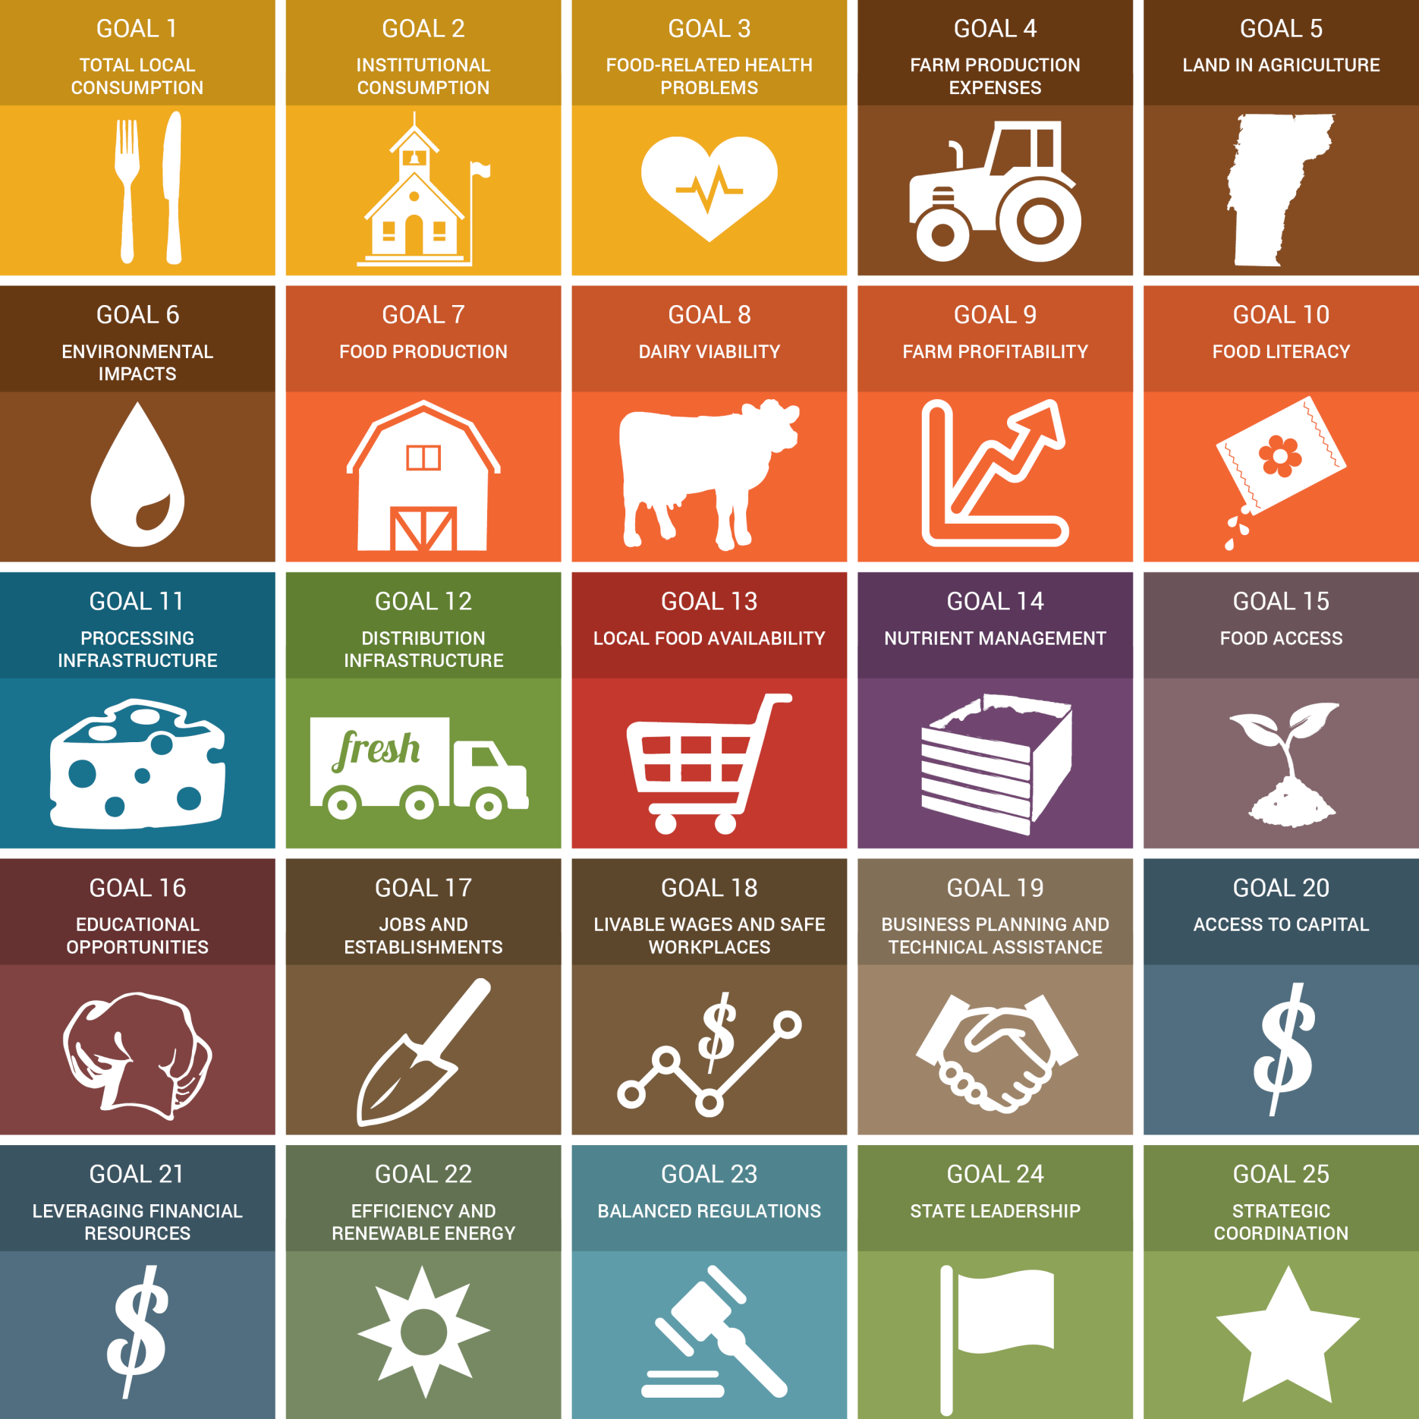

Slide 11
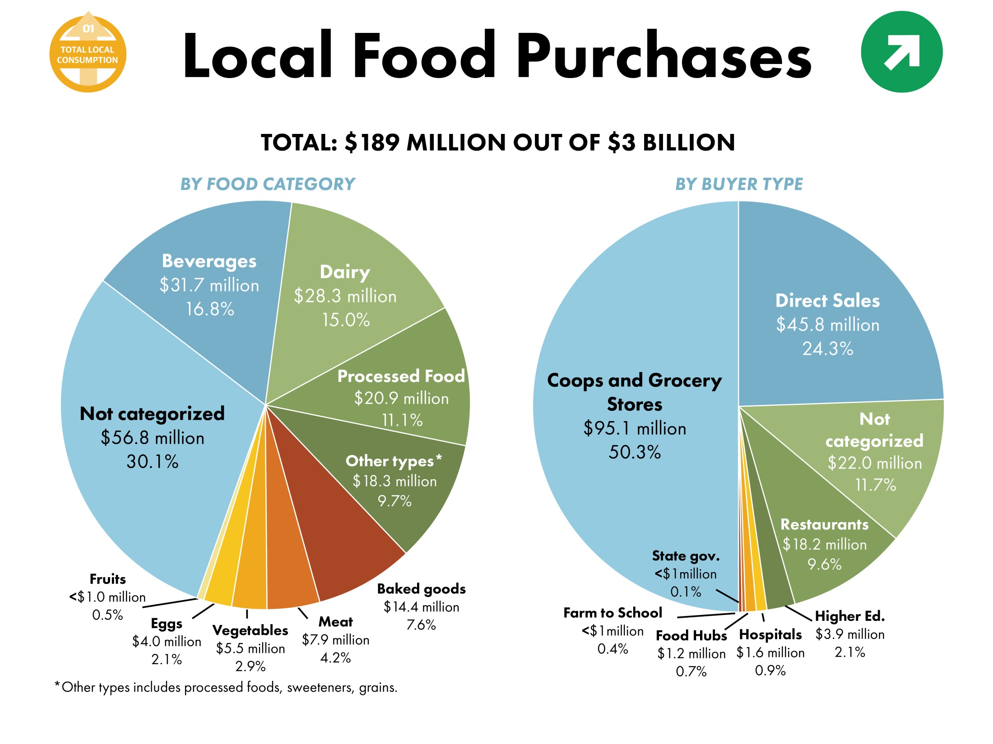

Slide 12
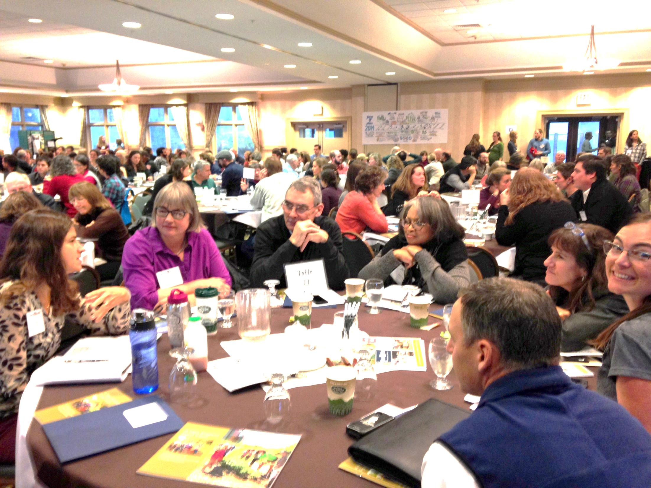
Moving from Planning to Action

Slide 13
Kania & Kramer, 2011

Slide 14
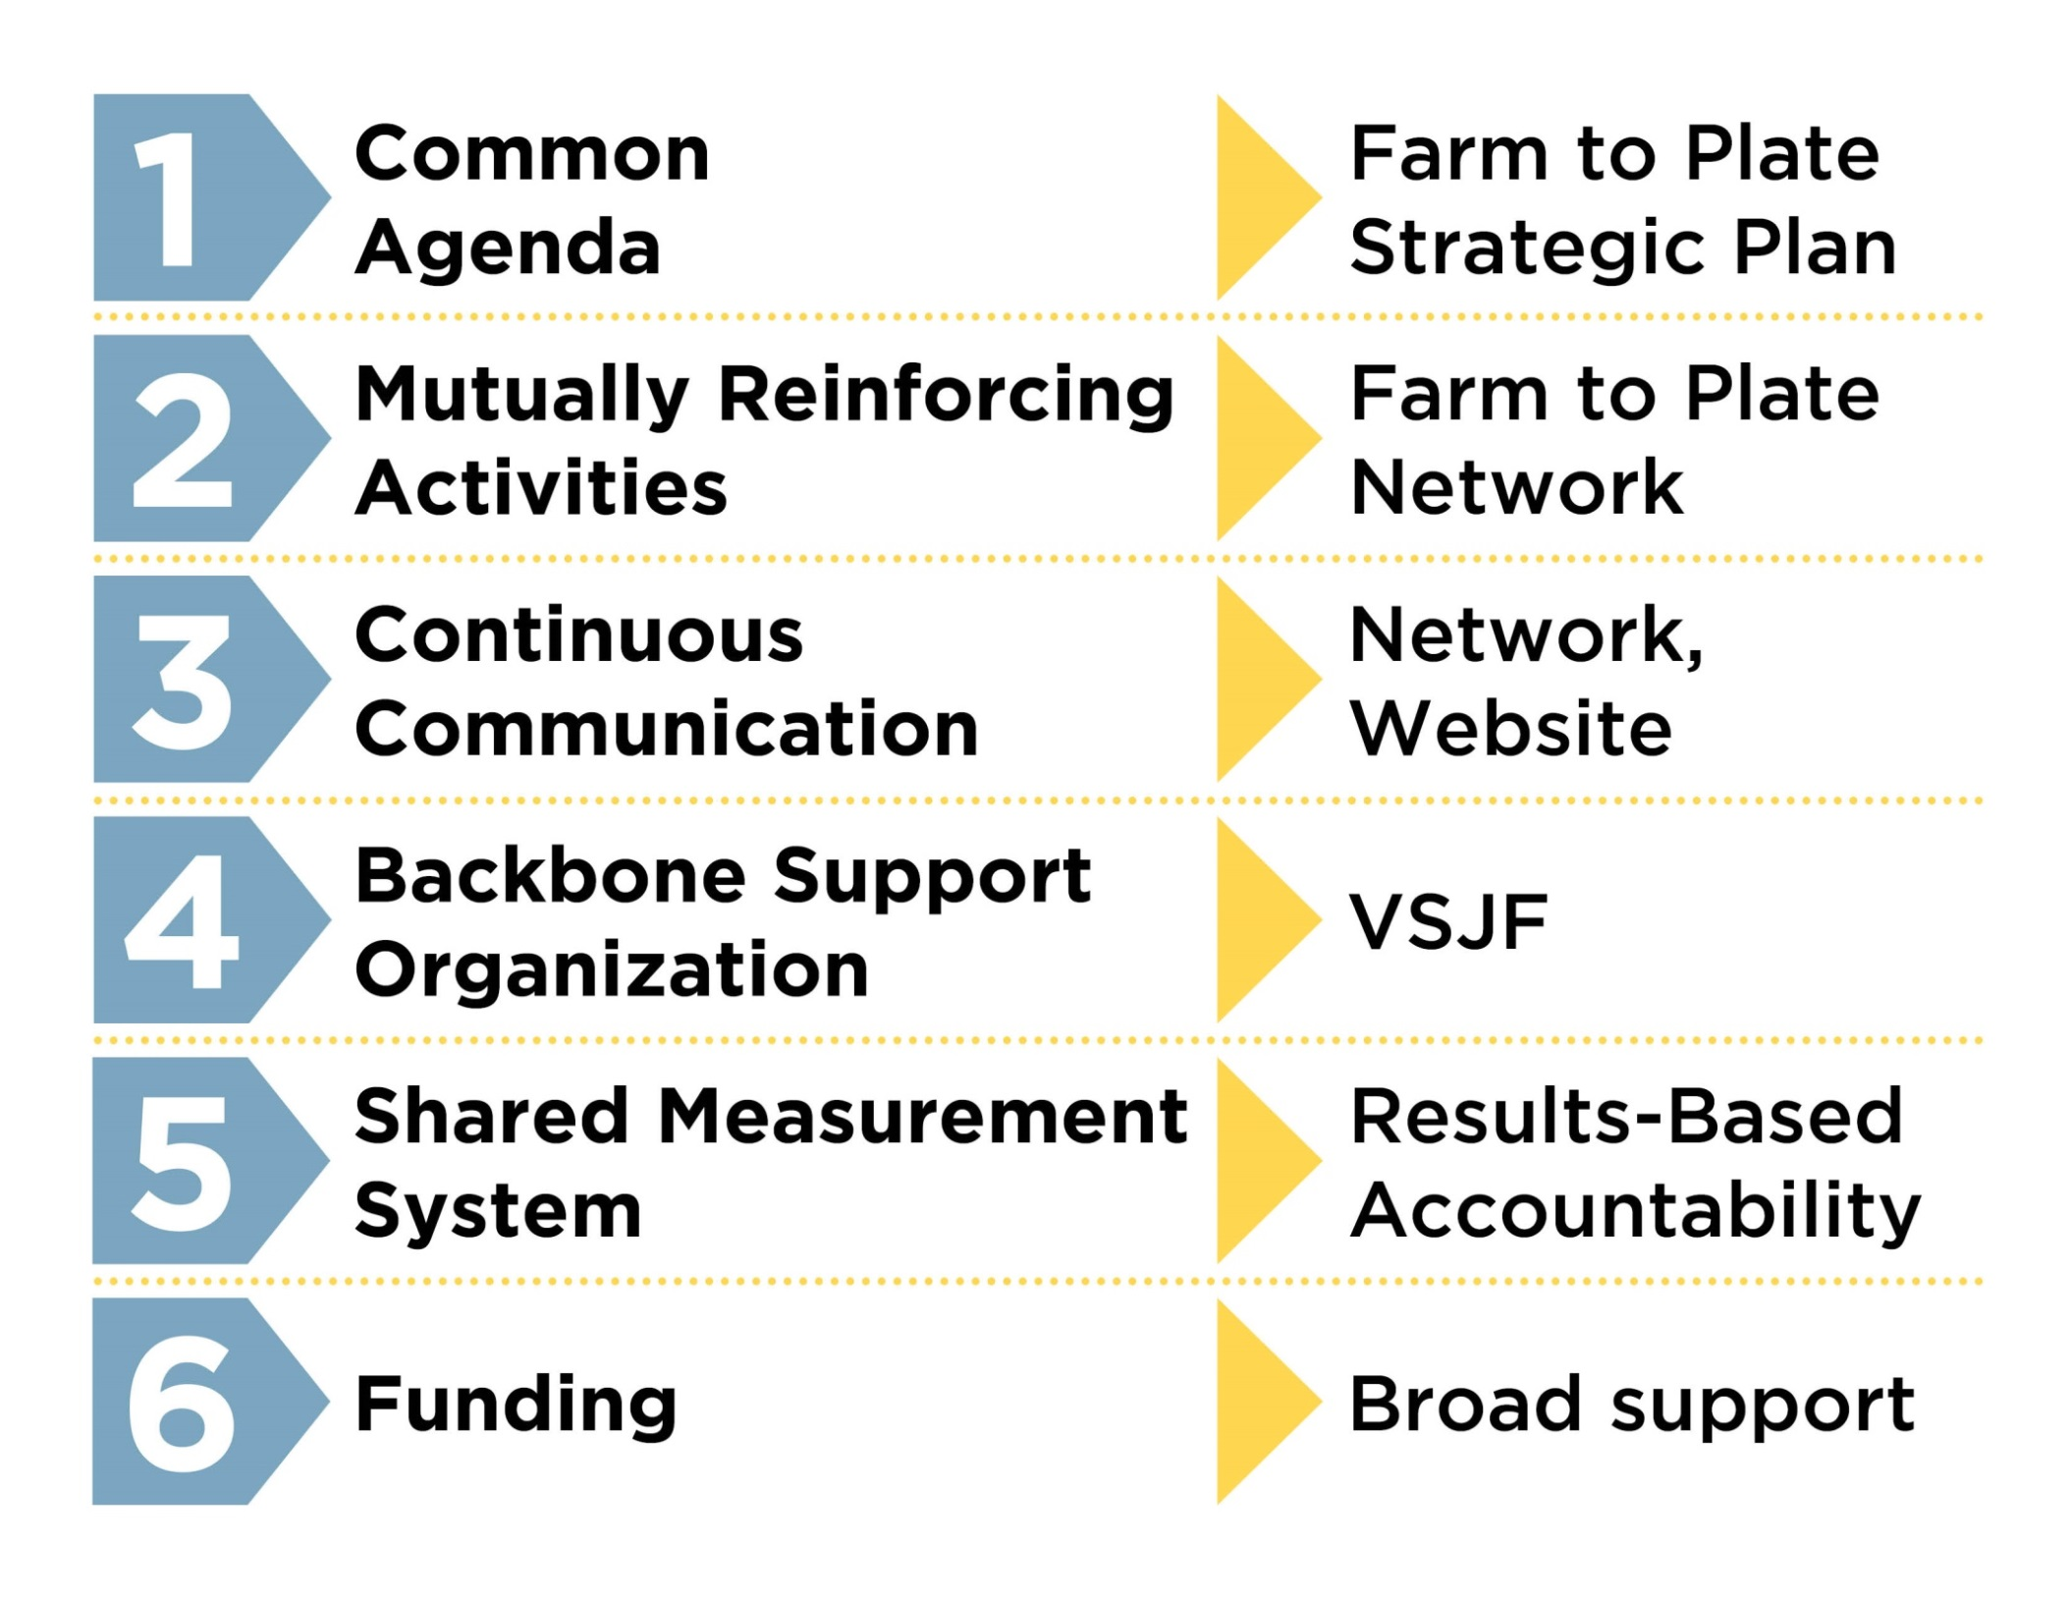
Collective Impact in Vermont’s Food System

Slide 15
1st Condition: Common Agenda
This is the “plan” with the “goals” of traditional planning
Systems level change initiative
The PROCESS by which the common agenda is built is most important; good design
Relationship & trust building – it takes time
Vision / mission bigger than any 1 organization
Will require diverse network to accomplish

Slide 16
2nd Condition: Mutually Reinforcing Activities
Activities are living embodiment of plan
Continuously assess gaps & opportunities to ID high leverage strategies and projects
Coordinate, collaborate, and differentiate
Form follows function – be adaptive
Build in time for reflection / adjustment / emergence + annual renewal and FUN!

Slide 17
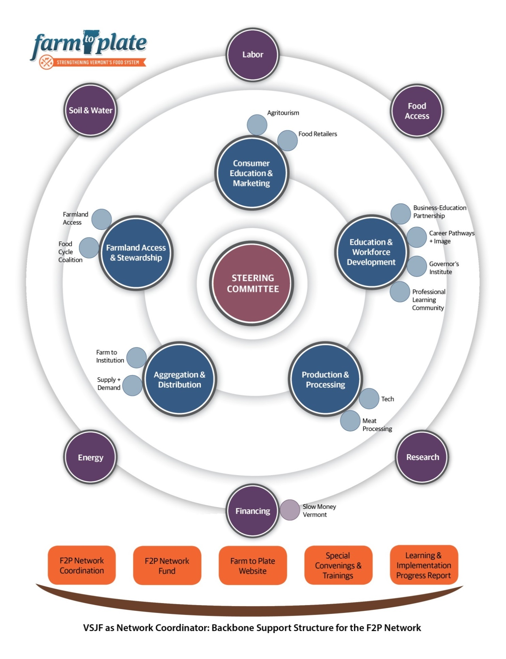

Slide 18
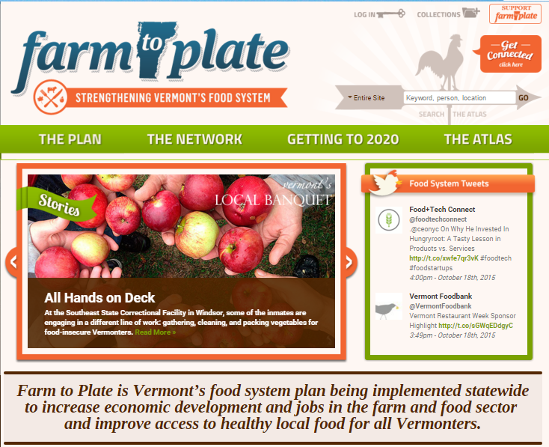
3rd Condition: Continuous Communication
www.vtfarmtoplate.com

Slide 19
Continuous Communication Essentials
In service to relationship building and connectivity
Transparency builds trust
Supports (and promotes) Network as a whole AND individual Network members
Accessible, frequent, timely information
In many forms and for different purposes

Slide 20
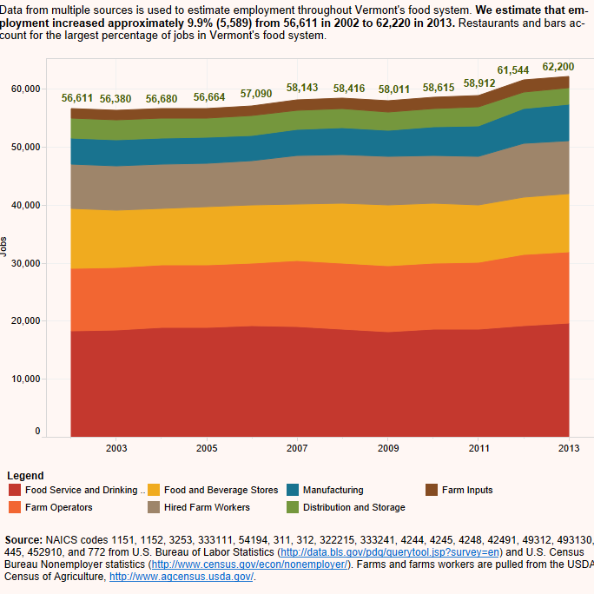
4th Condition: Shared Metrics
www.vtfarmtoplate.com/getting-to-2020

Slide 21
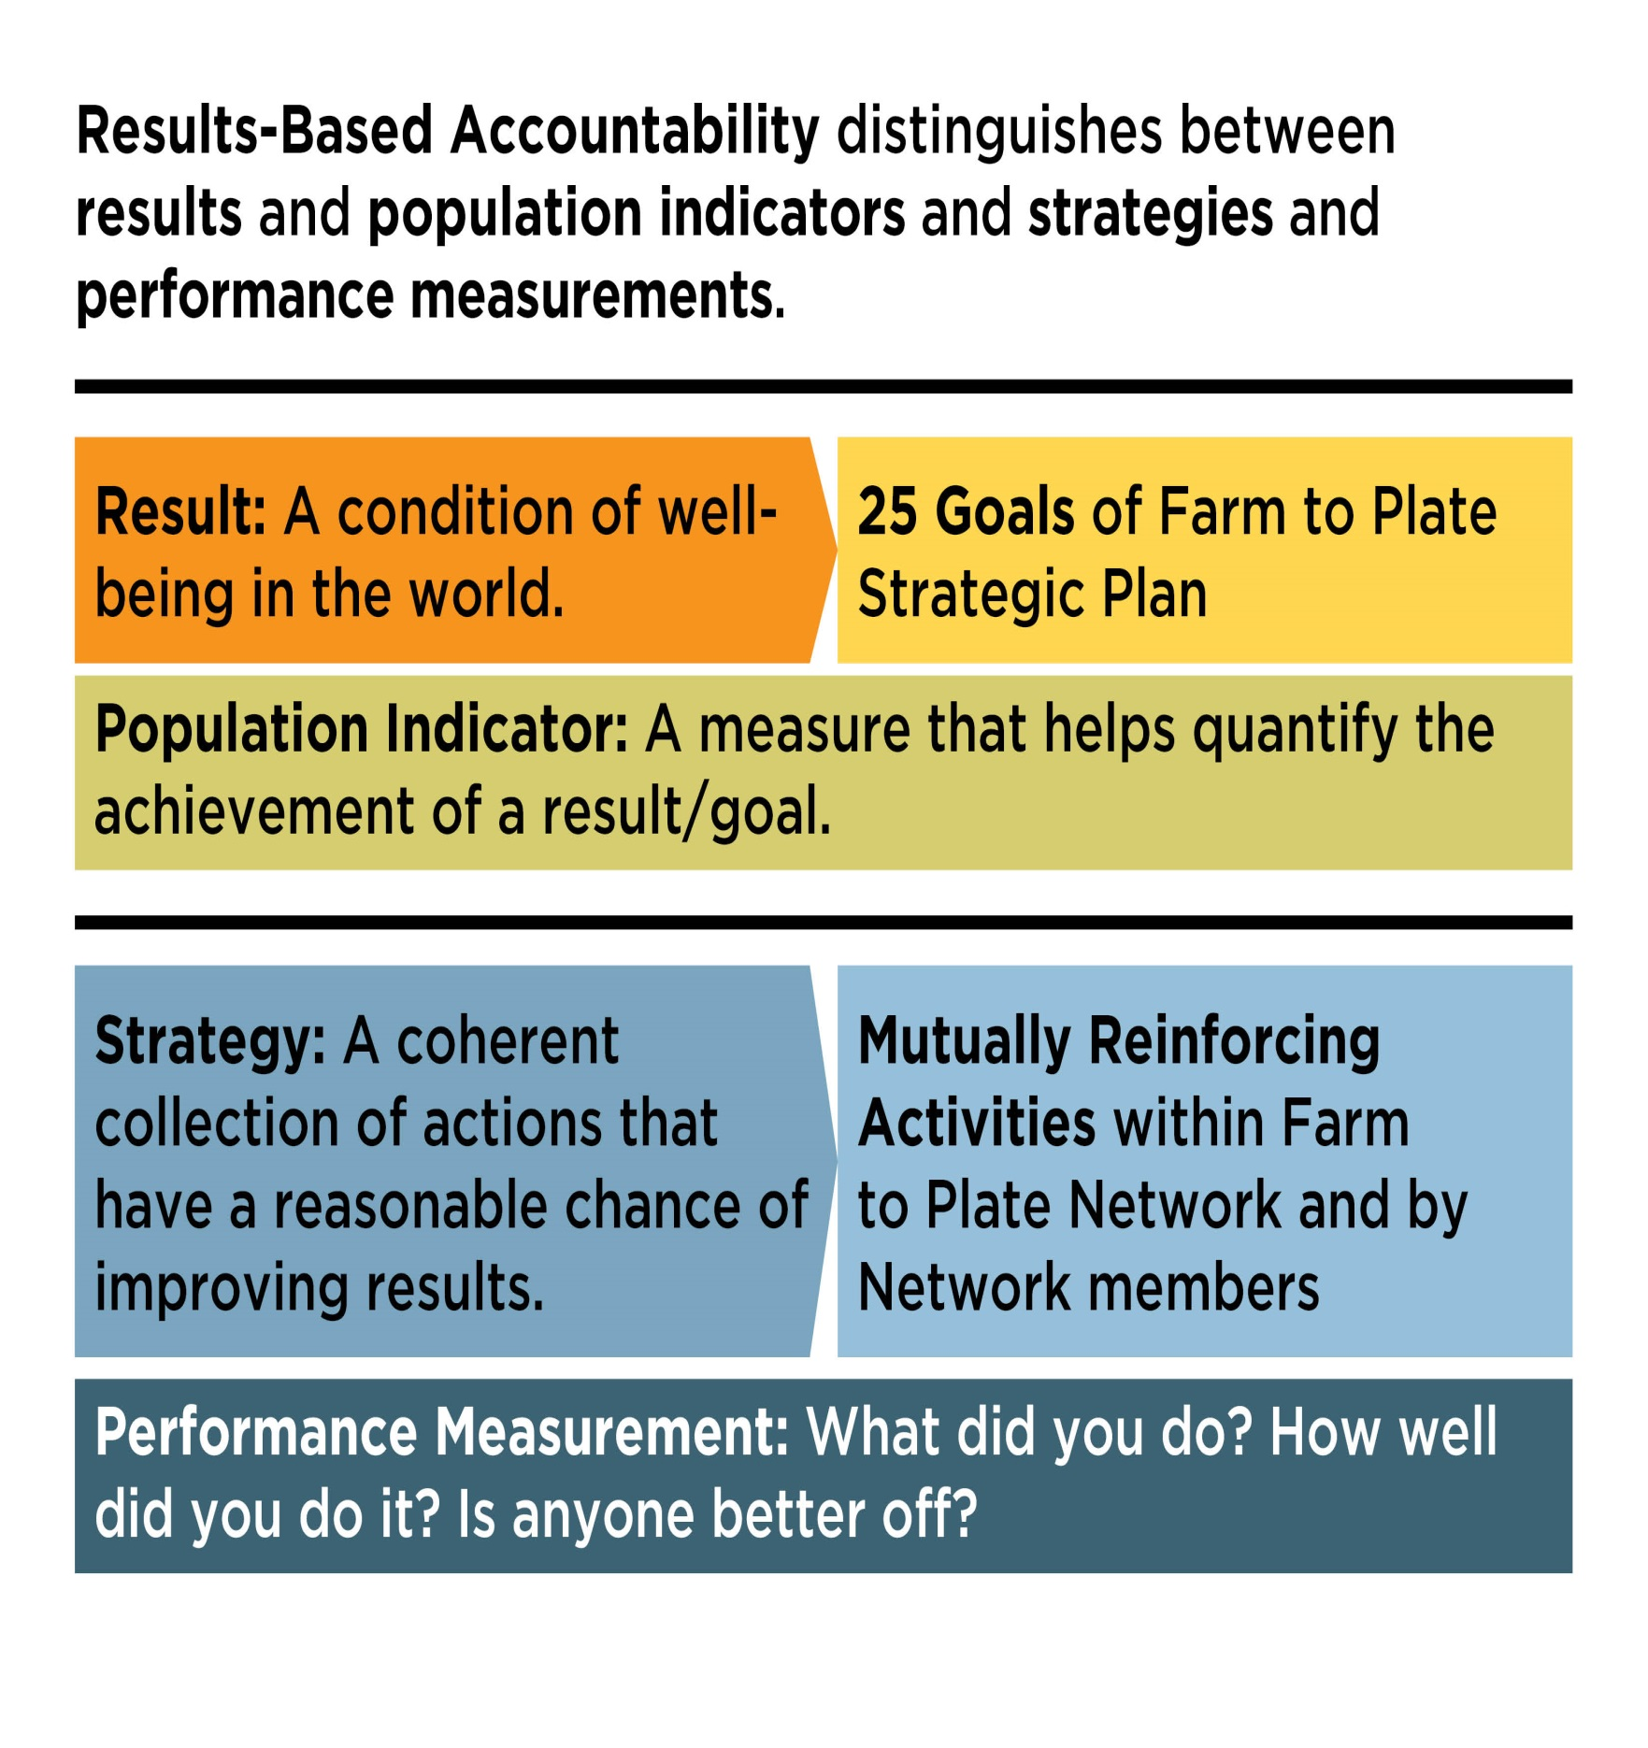

Slide 22
Metrics Essentials
Have an agreed upon metrics framework (e.g., RBA) and track progress over time
Build process to identify and collect the right data (from trusted sources, from members)
Linked with Continuous Communications – be “data-driven”
Trust is essential for systems of shared measurements

Slide 23
5 Condition: Network Coordinator Backbone Organization Services
Network administration & fundraising
Provide professional development and leadership training opportunities
Manage core Network communication needs / website
Track metrics; report on progress to Legislature and funders; evaluate performance of Network
Help guide vision and strategy; accountable to “whole”

Slide 24
A 6th Condition: Funding
Funding PARTNERS – from the beginning
Multi-year commitments to backbone org. + Network projects
Network Fund (mini-grants; 90 day projects)
Galvanize new funding – expand the pie; backbone should not compete with project funding

Slide 26
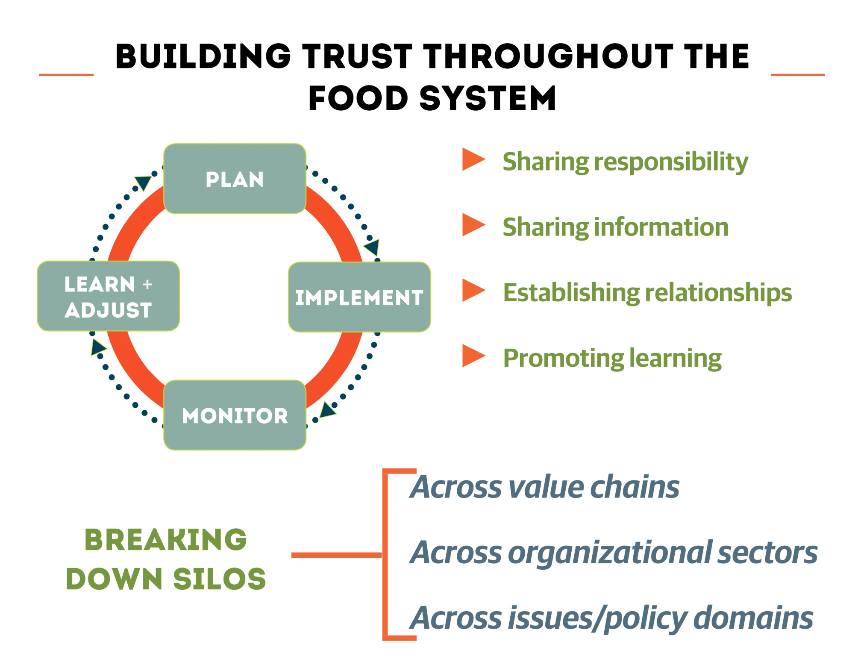

Slide 27
Network Leadership Lessons from F2P
Encourage shared ownership and develop structures for decentralized decision-making
Learn how to “hold the whole” and connect the dots (Network weaver, systems thinking, etc.)
Model behavior – how you want others to “show up” (promote transparency and trust)
Prototype and design thinking – fail forward fast
Practice early “wins” to build deeper relationships needed to do the harder work

Slide 28
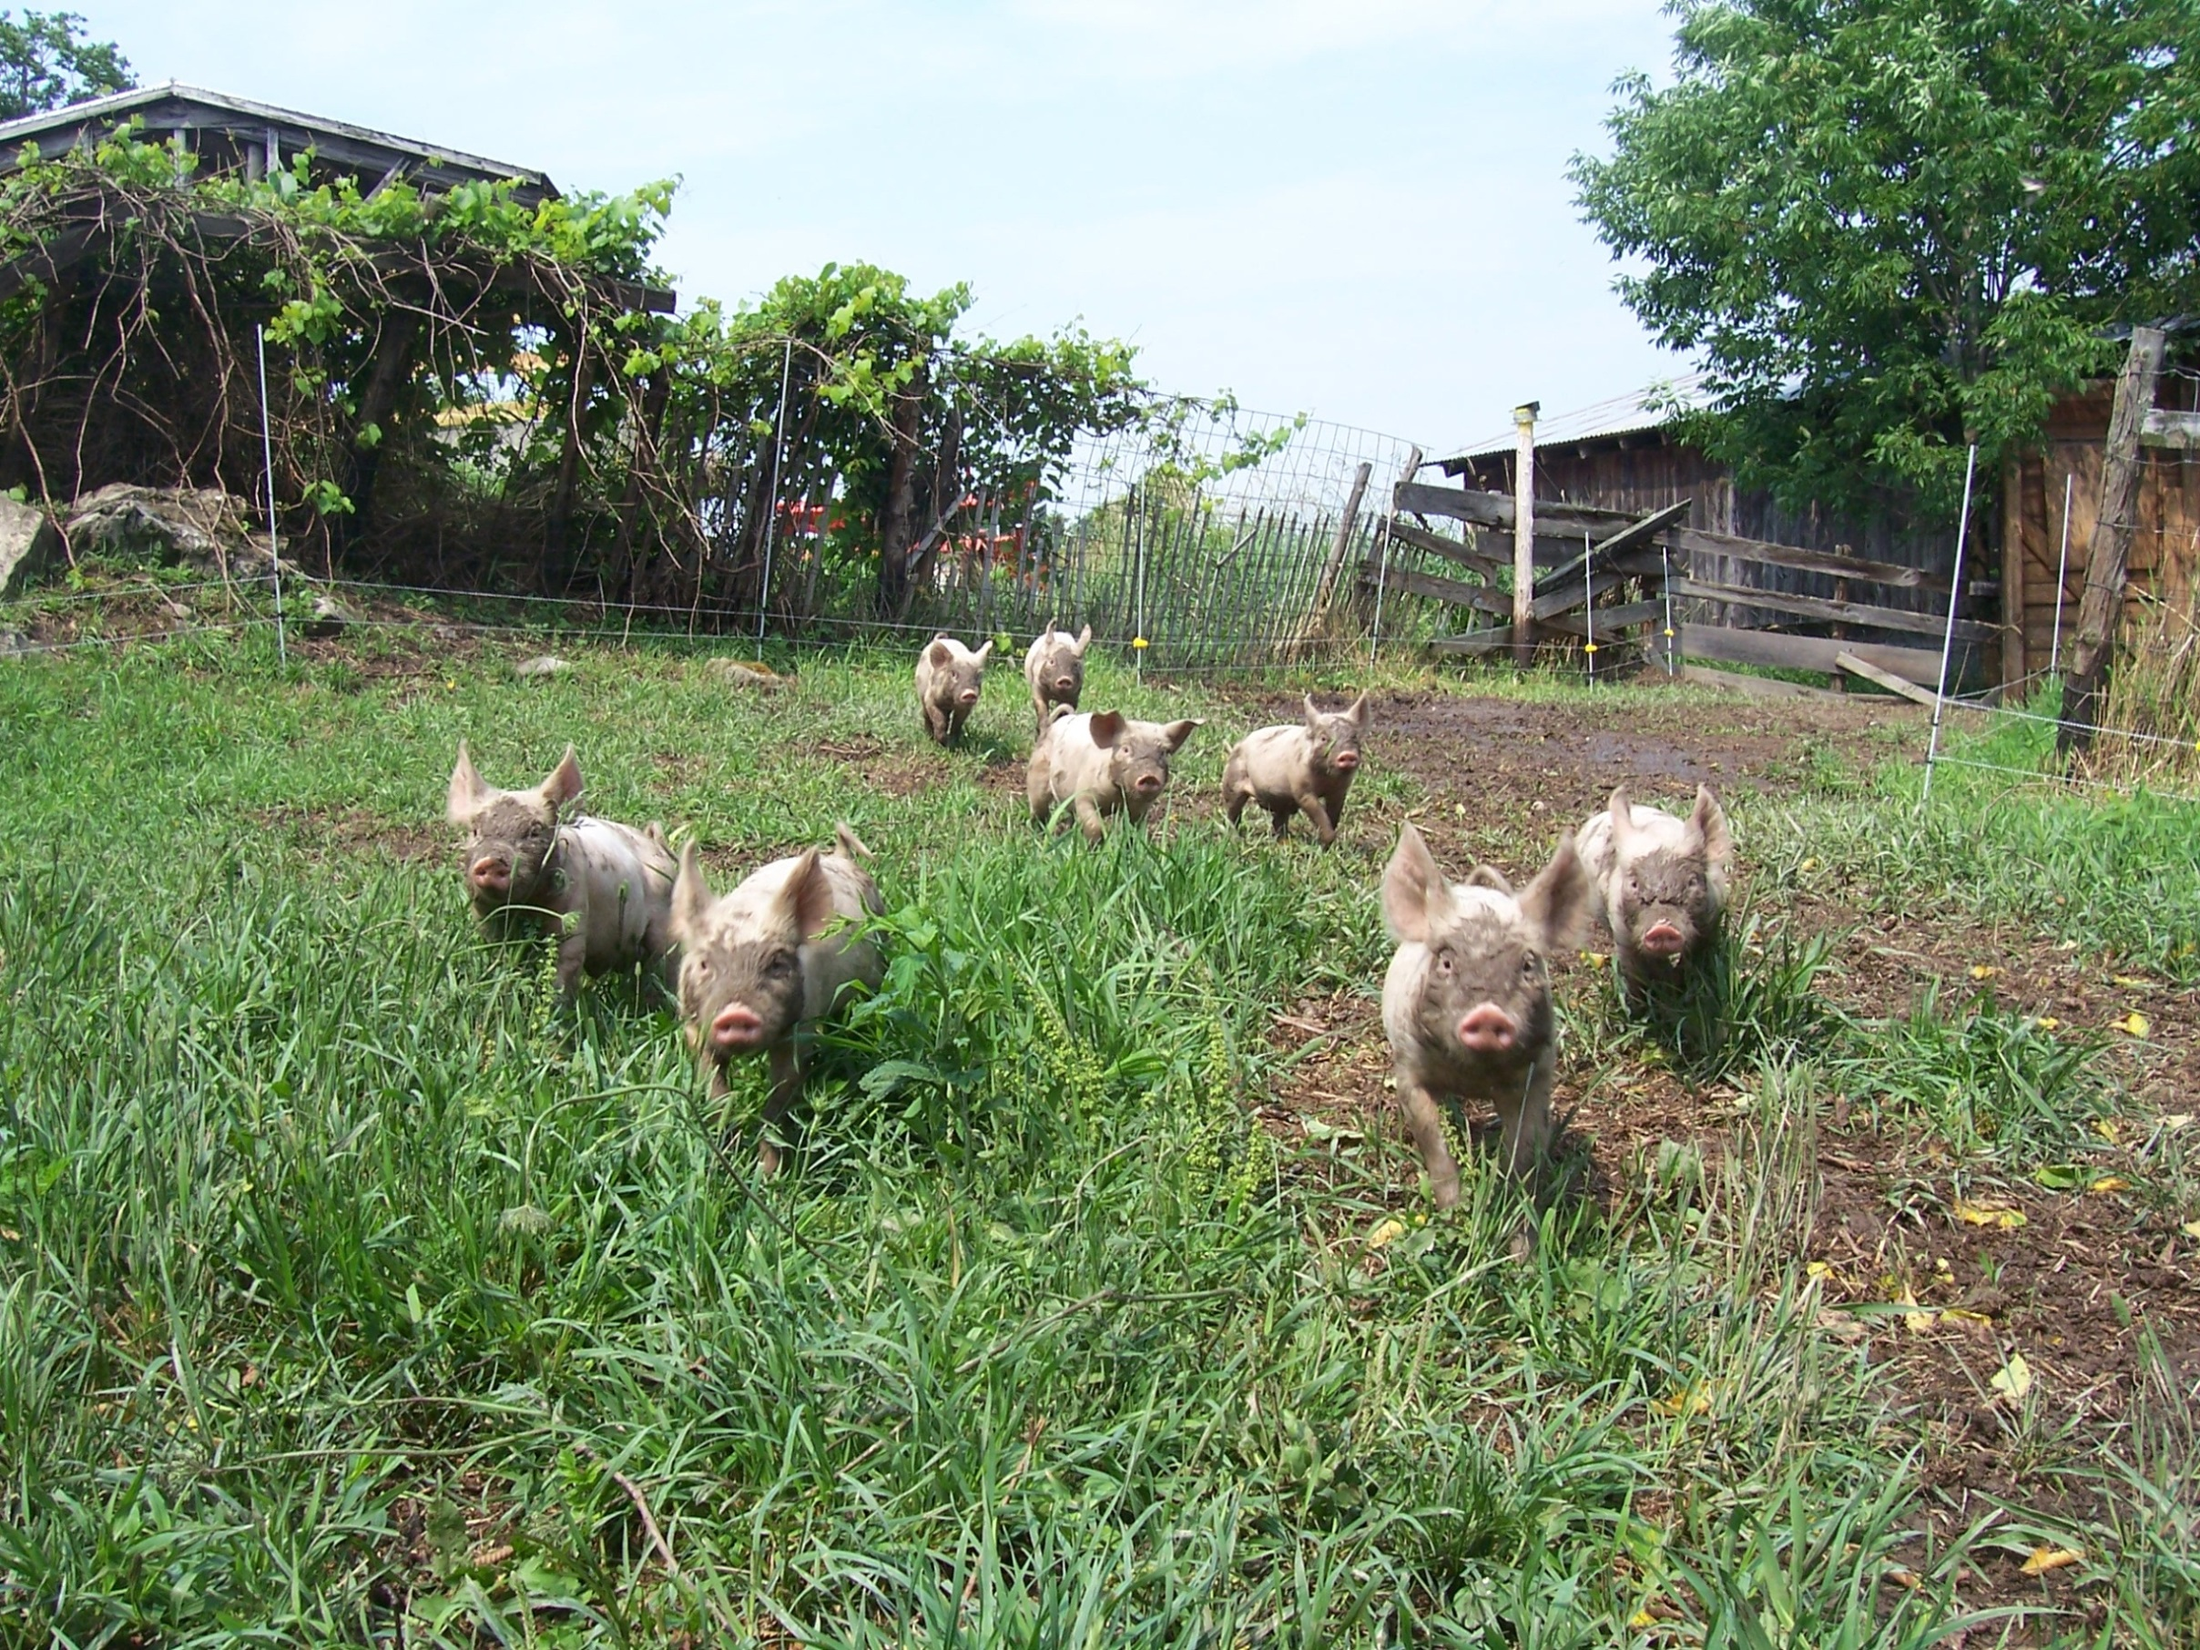
Thanks!

Slide 29
Finding Common Ground Summit
May 4 to 5, 2016
BCIT Downtown Vancouver
REGISTER AT: bit.ly/2016FCGsummit
Sustainable Food Systems Working Group

